Slide 1
Activity 1: How can a potato plant make a potato?

Slide 2
What is at potato made of?
Potatoes have:
Protein
Fat
Sugar
Starch
Fiber

Slide 3
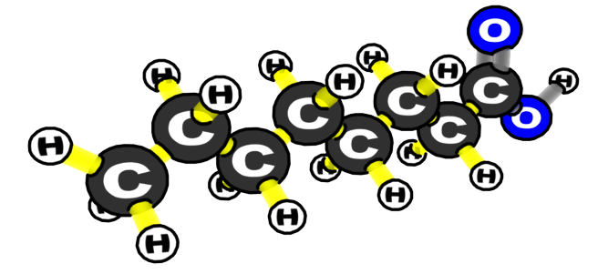
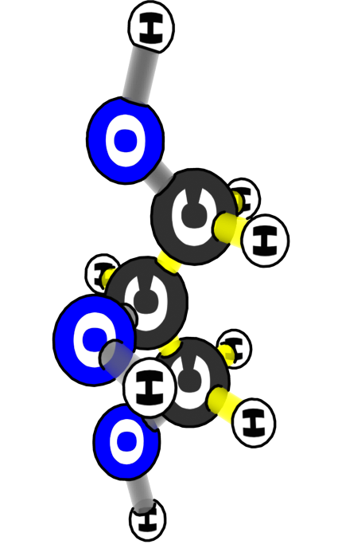
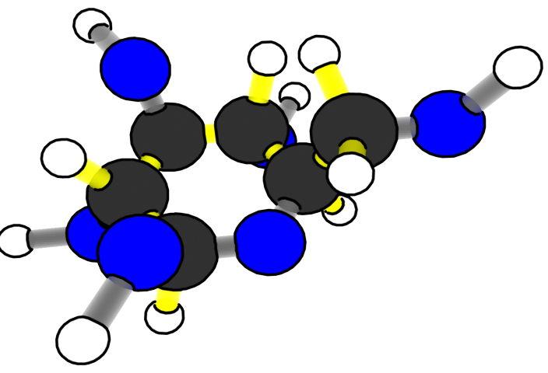
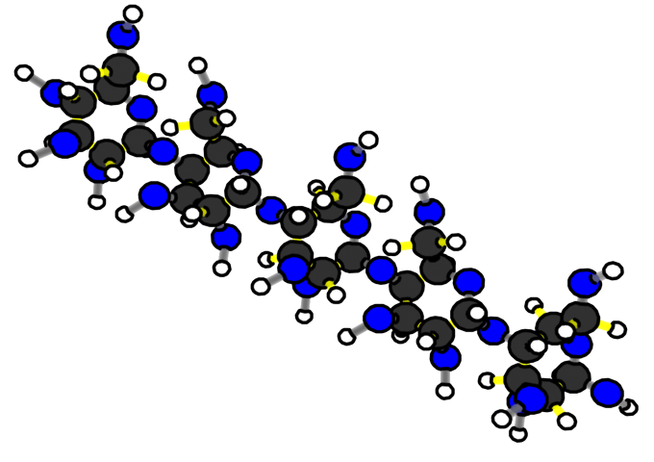
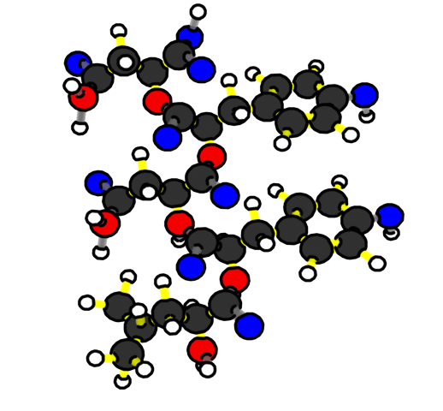
Potato Molecules
CARBBOHYDRATES:
FATS
GLUCOSE
STARCH
Where do these large organic molecules come from?
PROTEINS
Notes:
All of these molecules have C-C and C-H bonds, which store chemical energy

Slide 4
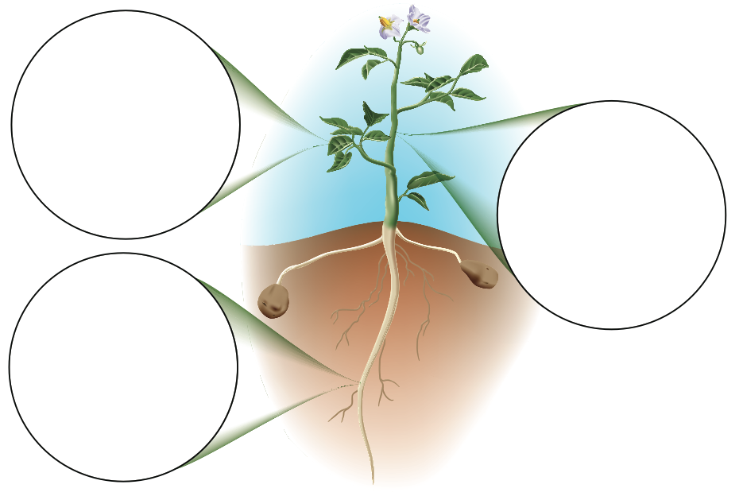
Use sticky notes to write your ideas.
How do the different parts of potato plants help to make all those molecules into potatoes?
Notes:
Check the class’s ideas: Nitrates and water come in from the roots, carbon comes in through the leaves.

Slide 5
Activity 2: What do soil, air, and water give to plants?

Slide 6
The Movement Question: What atoms go into potato plant roots?

Slide 7
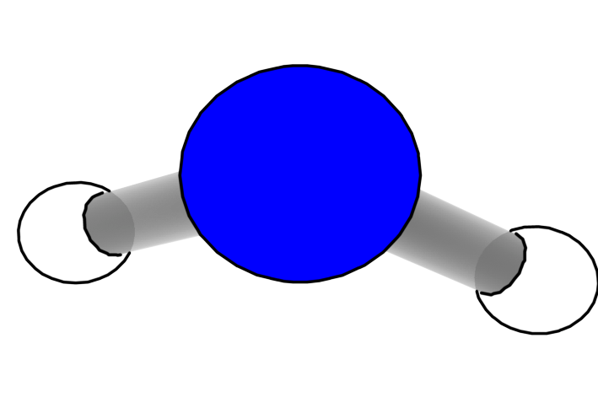
The Molecules in Water
Pure water contains only water molecules, but the water in streams and in our soil is not pure.
What other molecules are in water?

Slide 8
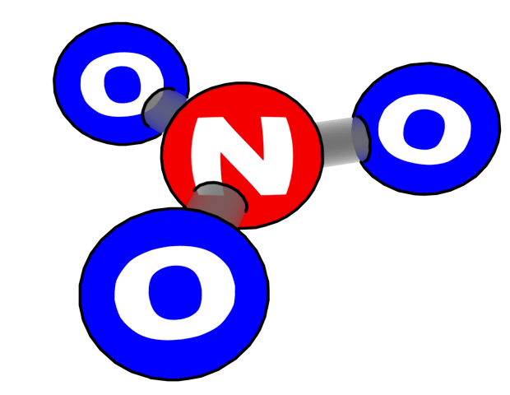
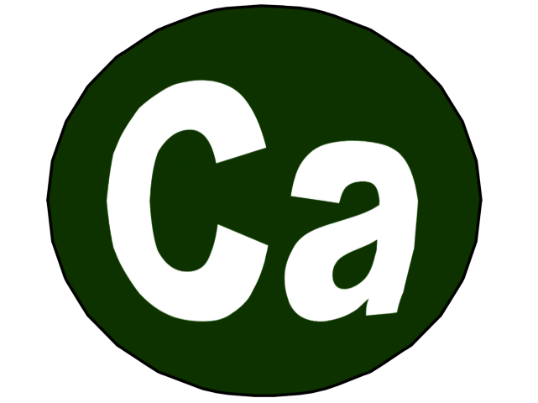
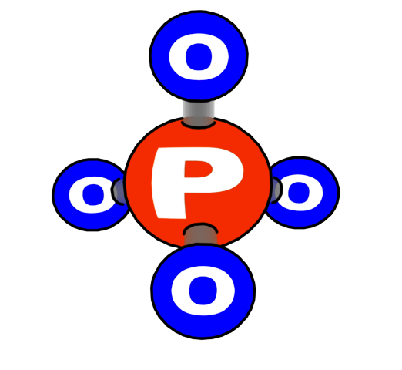
Dissolved Minerals in Water
Water also contains dissolved minerals that are nutrients for plants. These minerals have different kinds of atoms, including:
Nitrogen
Phosphorous
Calcium
Sodium

Slide 9
The Movement Question: What atoms go into potato plant leaves?

Slide 10
Gases in Air
Air is made of gases, including:
Nitrogen (N₂)
Oxygen (O₂)
Carbon dioxide (CO₂)

Slide 11
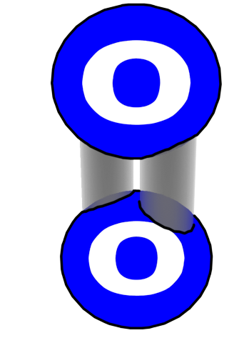
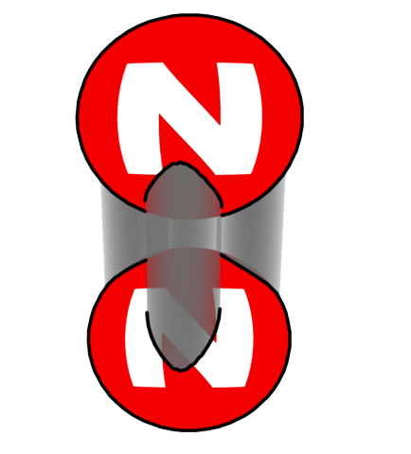
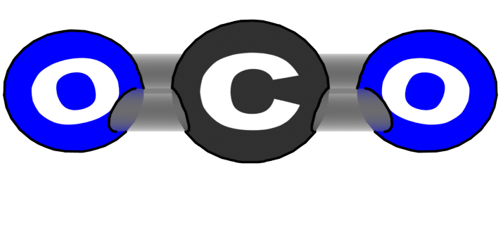
Gases in Air*
Air is made of gases, including:
Nitrogen (N₂)
Oxygen (O₂)
Carbon dioxide (CO₂)
*All of these gases are found in air. Which molecule is taken in during photosynthesis?

Slide 12
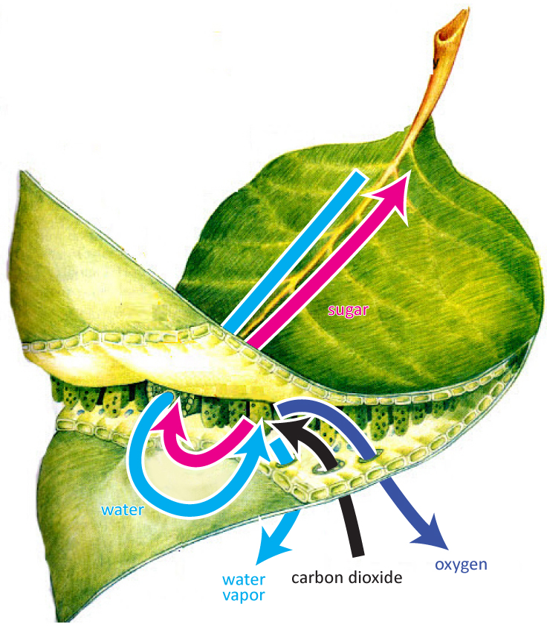
Leaf: Movement of atoms during photosynthesis
Question: Where does the sugar go?
Notes:
Note that CO2 is entering from the leaves and water is entering from the other part of the plant. Then, water and oxygen are leaving the plant and sugar is getting sent to other parts of the plant.

Slide 13
Activity 3: Modeling Biosynthesis
Cut up your molecule cards and have them ready to go!

Slide 14
Starting points:
Put glucose molecules in the potato plant’s leaves.
Put water and minerals in the potato plant’s roots.

Slide 15
Next steps:
Move the glucose, water and minerals to the potato.

Slide 16
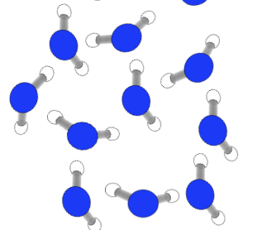
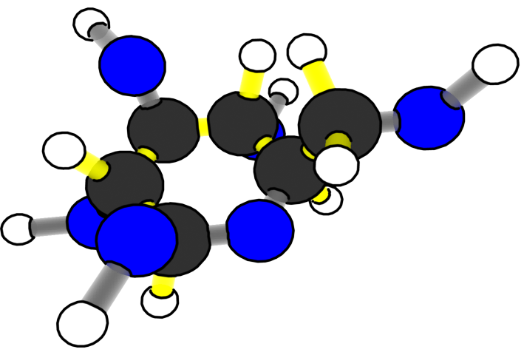
What happens inside the growing potato?
Water | Minerals
Glucose
Now that these materials have reached the potato, how does the plant use them to make a potato?
Notes:
CO2 and water go in, glucose is created, and O2 comes out.

Slide 17
BIOSYNTHESIS!

Slide 18
Biosynthesis is how a plant uses the sugar made during photosynthesis and minerals from the soil to create larger organic molecules that build the body of its cell walls, and water.

Slide 19
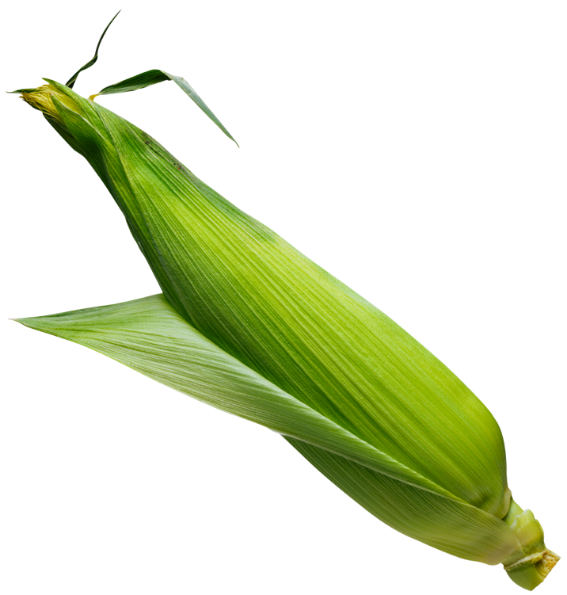
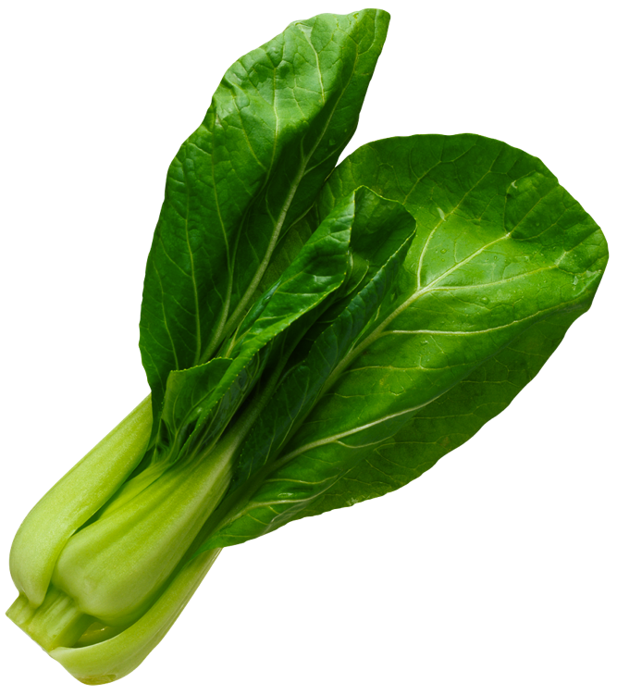
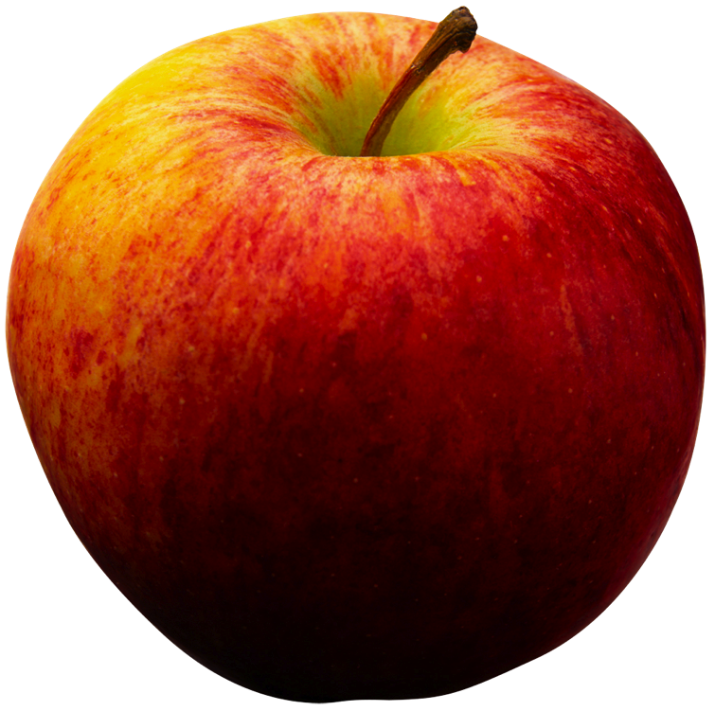
Biosynthesis
How does a plant use glucose (from photosynthesis) and minerals (from the roots) to build a plant’s biomass?

Slide 20
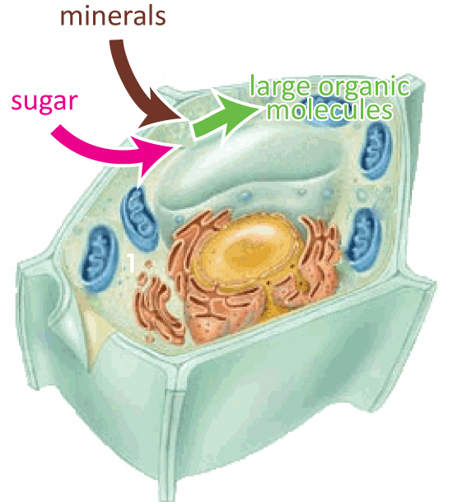
Movement of atoms during Biosynthesis

Slide 21
Polymers & Monomers
Plants are made of three basic large organic molecules, or polymers:
Carbohydrates (sugar, starch, fiber)
Fats
Protein
Polymers are built from smaller organic molecules called monomers.
Glucose and other simple sugars (put together = carbohydrates)
Glycerol and fatty Acids (put together = fats)
Amino Acids (put together = proteins)

Slide 22
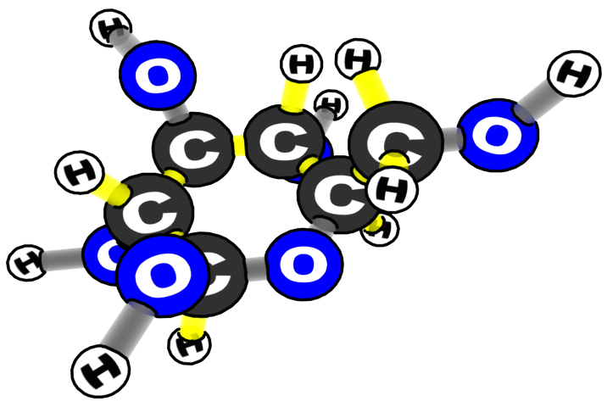
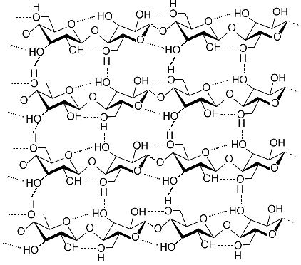
What are potatoes made of?CARBOHYDRATES
fiber (cellulose)
glucose
starch
Glucose molecules move from the leaves to the growing potato under the ground.

Slide 23
What are potatoes made of? FATS
Plants can rearrange the C, H, and O atoms in glucose to make glycerol and fatty acids.
1 glycerol
3 fatty acids
What atoms are fats made of?

Slide 24
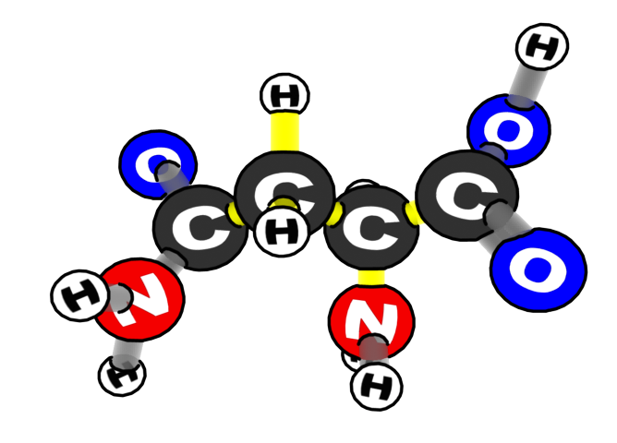
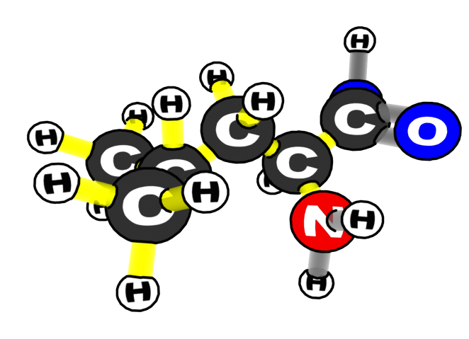
What are potatoes made of? PROTEIN
Two of the amino acids
Plants make amino acids from glucose and nitrate from the soil.

Slide 25
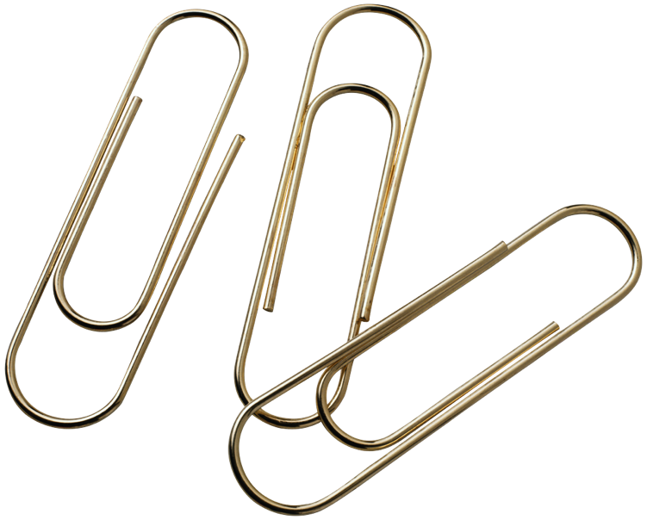
Constructing Monomers
Directions:
Build 5 glucose monomers
(glucose =1 glucose + 1 paper clip)
Build 3 fatty acid monomers
( fatty acid = 1 fatty acid + 1 paper clip)
Build 1 glycerol monomer
(glycerol = 1 glycerol + 1 paper clip)
Build 3 amino acid monomers
(amino acid = 1 amino acid + 1 paper clip)

Slide 26
1. CARBOHYDRATES (starch)
Starch molecules (polymers) are built from chains of glucose (monomers).
many glucose monomers = 1 starch polymer
Monomer = 4 glucose molecules
Polymer = Starch

Slide 27
1. FATS
Fat molecules (polymers) are built from 3 fatty acids and 1 glycerol (monomers).
3 fatty acids
1 glycerol
Monomer = 3 Fatty Acids, 1 glycerol
Polymer = Fat

Slide 28
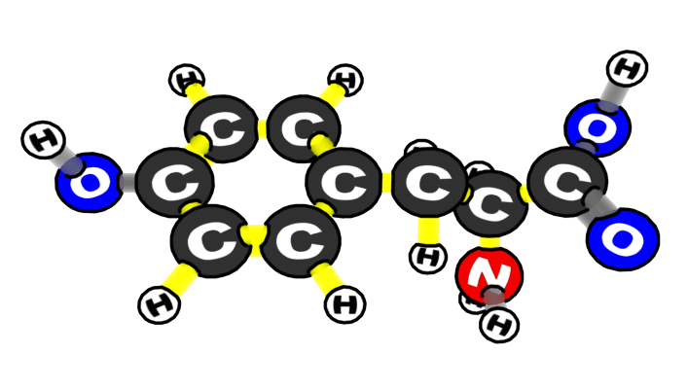
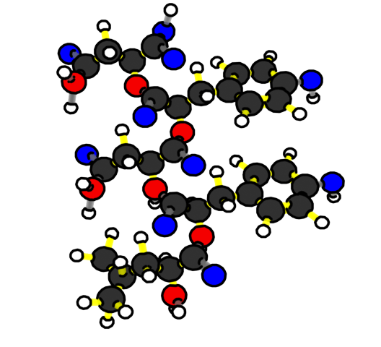
3. PROTEIN
Protein molecules (polymers) are built from chains of amino acids (monomers).
Many amino acid monomers = 1 protein polymer
Monomer = Amino Acids
Polymer = Proteins

Slide 29
Constructing Polymers
Directions:
Build 1 starch polymer
(starch = many glucose monomers)
Build 1 fat polymer
( fat = 3 fatty acids + 1 glycerol)
Build 1 protein polymer
(protein = many amino acid polymers)

Slide 30
Constructing Polymers
Polymers are used to build new
cells in all parts of the plant
(roots, leaves, stems,
flowers, seeds, tubers, etc).

Slide 31
Use this poster to tell two stories.
Story 1: How did a carbon atom in a CO₂ molecule in the air end up in the starch molecule of a potato?
Story 2: how did light energy from the sun end up in the bonds of a starch molecule in a potato?
Notes:
Use this slide to make connections between the monomers and polymers on the students’ desks to a real plant.
Matter tracing: Where are these polymers located in a plant? Encourage students to tell a story about a carbon atom that starts in a CO2 molecule and ends up as a starch molecule in a potato.
Energy tracing: Ask students to construct a similar story with energy. How does energy that begins at the sun end up in a starch molecule in a potato?

Slide 32
Plant Growth: The Carbon and Energy Questions
Carbon: Where do the atoms that make up carbohydrates, fats, and proteins come from?
Carbon: from CO₂ to glucose made in photosynthesis
Oxygen: from CO₂ to glucose made in photosynthesis
Hydrogen: from H₂O to glucose made in photosynthesis
Nitrogen: from soil minerals
Energy: Where does the chemical energy in the high-energy (C-C and C-H) bonds of carbohydrates, fats, and proteins come from?
From light to C-C and C-H bonds in glucose made in photosynthesis

